Slide 1

When Mechanical Engineering marries Imaging:
Multiscale Biomechanics in
Hard and Soft Tissues
​
Junning CHEN | PhD in Biomedical Engineering
Lecture of Biomechanics
Department of Engineering
University of Exeter
j.chen3@exeter.ac.uk / jche8767@gmail.com

Slide 2
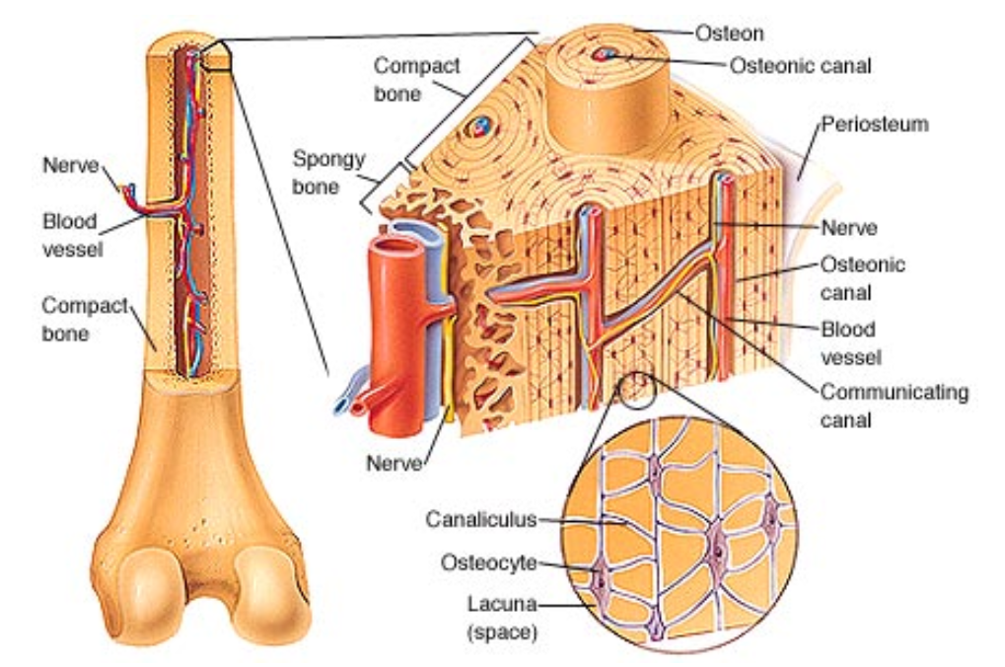
骨细胞网络结构
骨骼的层级结构
骨单元
骨单元髓腔
骨小管
骨细胞
骨细胞室

Slide 3
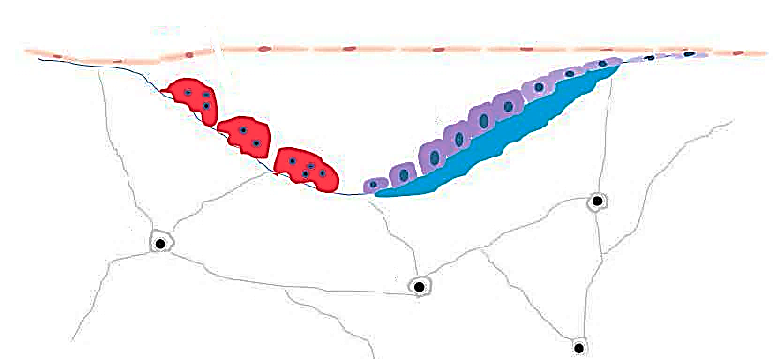
骨细胞网络结构
骨骼的层级结构
(Image courtesy of Boneawald, 2011, JBMR; Hinge et al., 2013, Oncology)
成骨细胞
蚀骨细胞
骨细胞

Slide 4
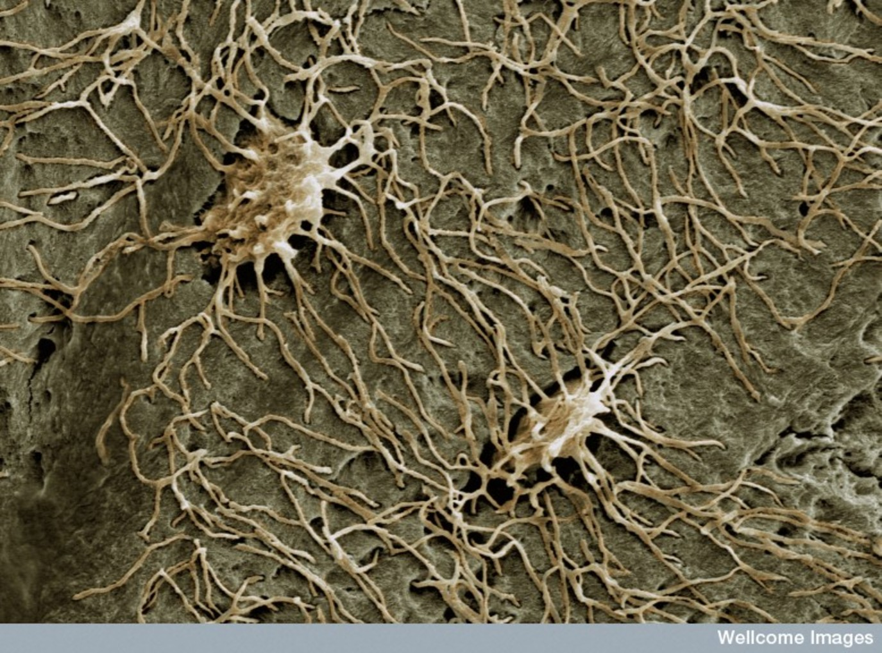
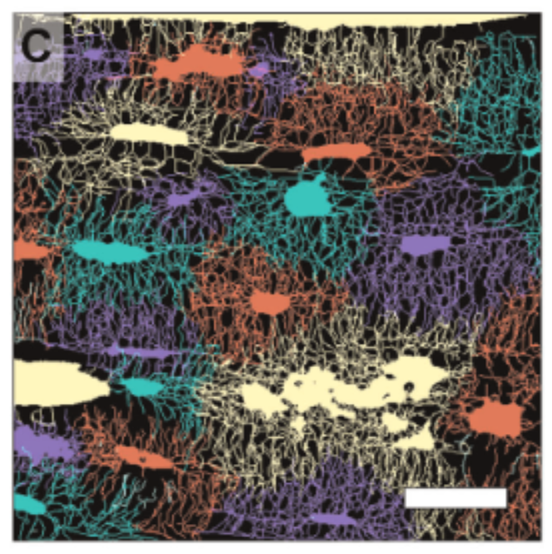
骨细胞网络结构
Image Courtesy of Prof. Lynda Bonewald, the “Lady Osteocyte”
骨细胞 (住在骨细胞室内)
骨小管
骨骼重
应力感知
钙平衡
10 µm
(Kerschnitzki, et al., 2013, J Bone Miner Res)

Slide 5
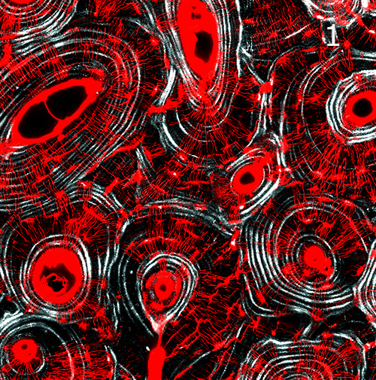
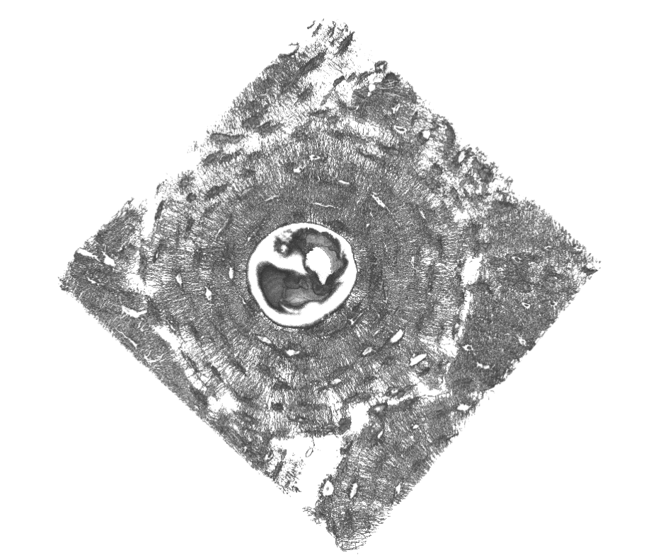
Confocal Laser Scanning Microscopy
(Repp, et al., J Struct Biol, 2017)
细胞室
骨髓腔
50 µm
骨小管

Slide 6
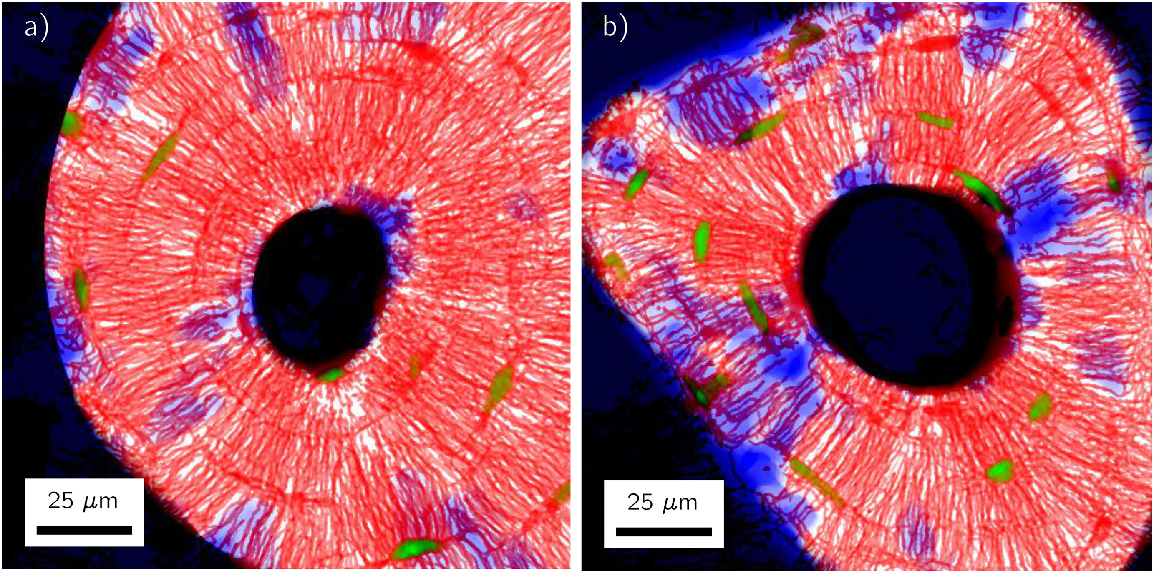
以网络拓扑特性来判断骨单元年龄
(Repp, et al., Bone Reports, 2017)
新生的骨单元
衰老的骨单元

Slide 7
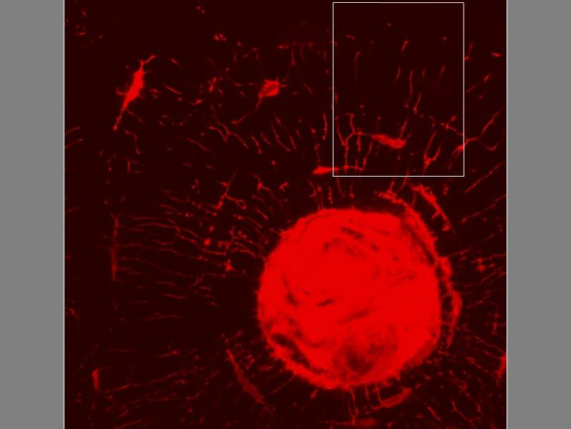
网络标记
(Repp, et al., J Struct Biol, 2017)
细胞室
Lacuna
骨髓腔
HS Channel
Canaliculus
骨小管

Slide 8

网络标记
(Repp, et al., J Struct Biol, 2017)
细胞室
Lacuna
骨髓腔
HS Channel
Canaliculus
骨小管

Slide 9
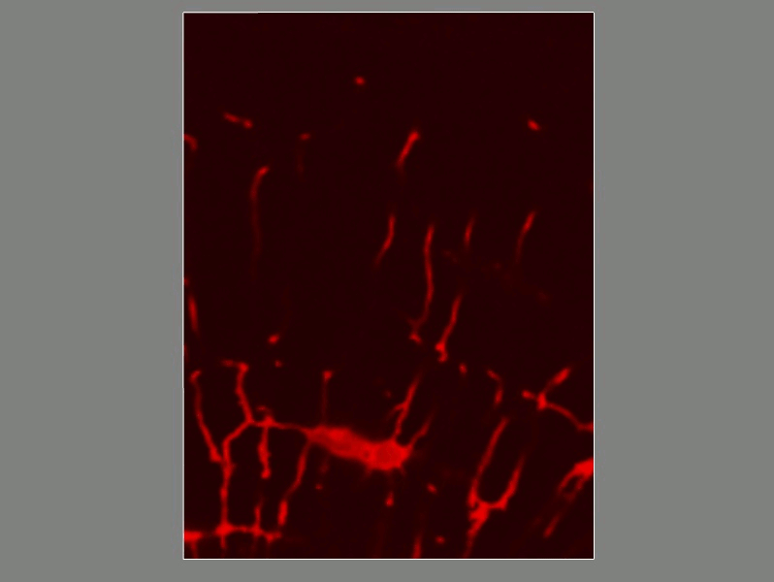
网络标记
(Repp, et al., J Struct Biol, 2017)
细胞室
高斯差异
Lacuna
骨髓腔
HS Channel
Canaliculus
骨小管

Slide 10
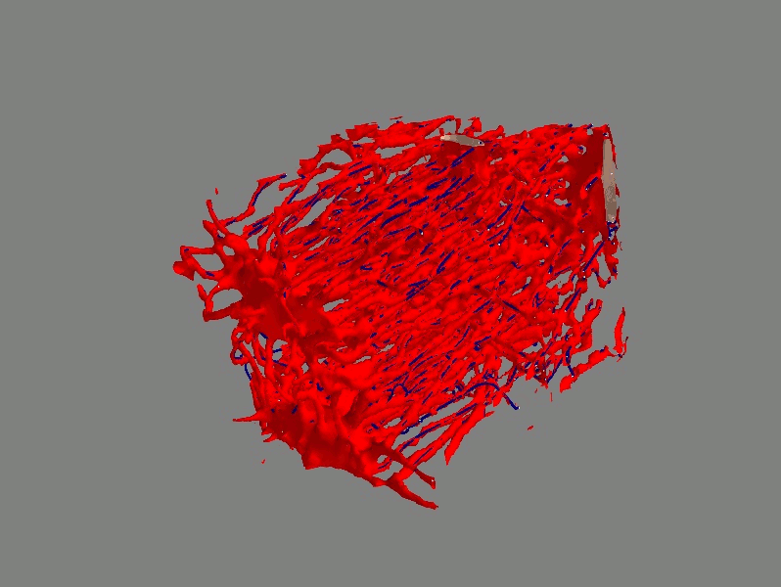
网络数字化
(Repp, et al., J Struct Biol, 2017)
细胞室
中线拟合
Lacuna
骨髓腔
HS Channel
Canaliculus
骨小管

Slide 11
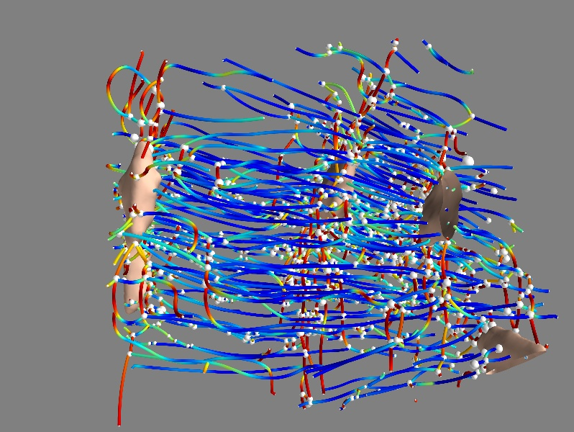
网络数字化
(Repp, et al., J Struct Biol, 2017)
细胞室
计算拓扑参量
Lacuna
骨髓腔
HS Channel
Canaliculus
骨小管

Slide 12
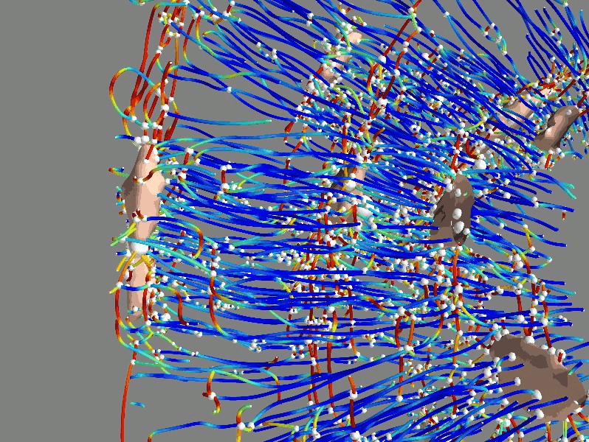
计算网络拓扑参数
(Repp, et al., J Struct Biol, 2017)
细胞室
计算拓扑参数
Lacuna
骨髓腔
HS Channel
Canaliculus
骨小管

Slide 13
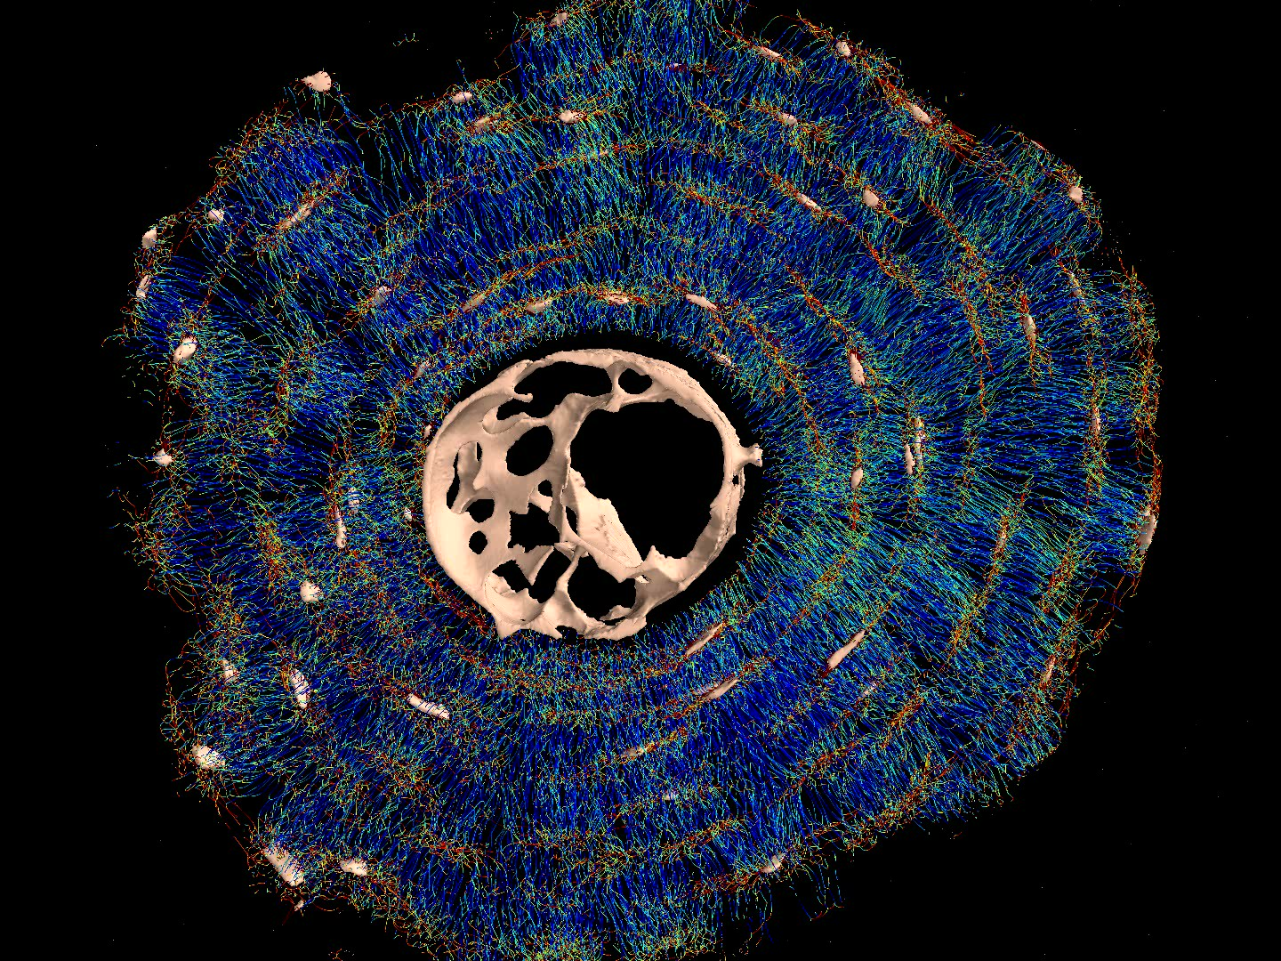
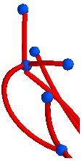
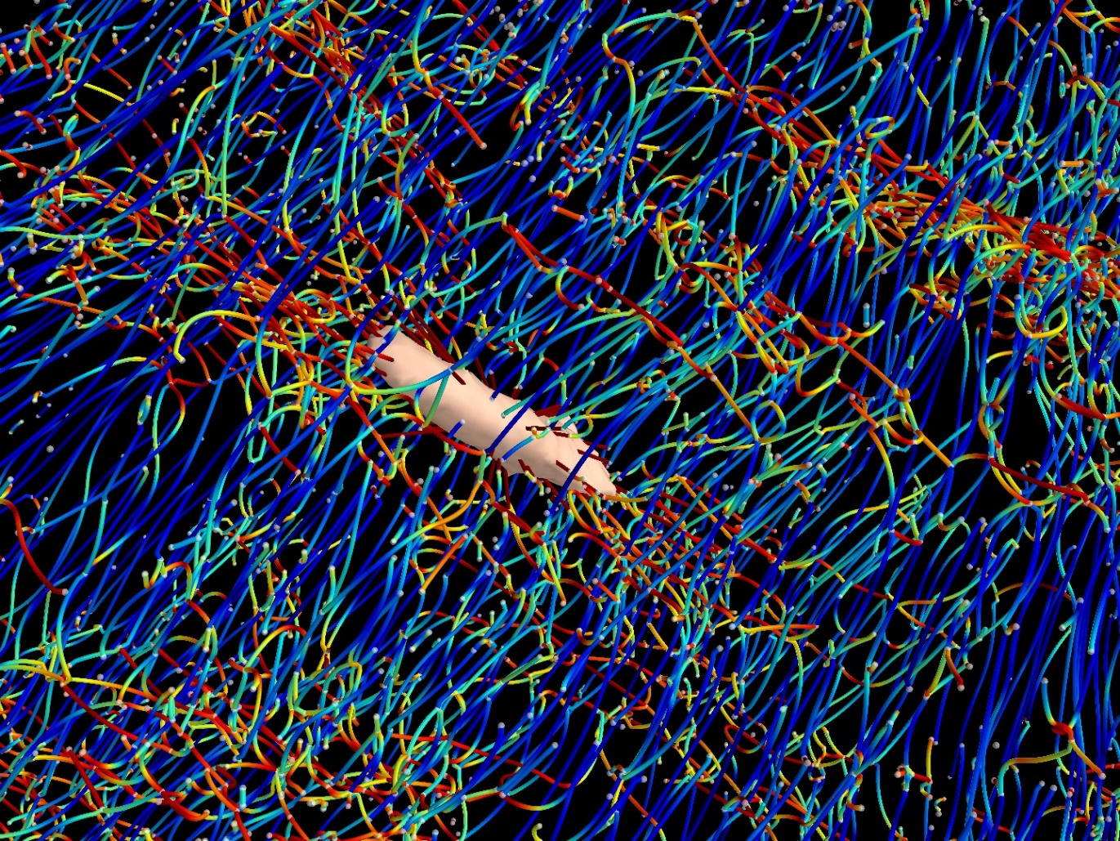
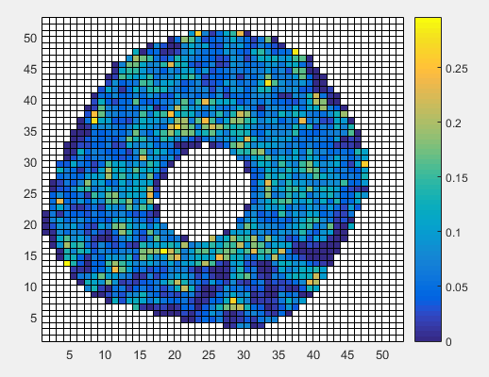
网络量化
(Roschger, et al., Bone, 2019)
网络长度
Length = 1.65 µm
`
网络连接度
DOC = 4
DOC = 3
网络密度
100 µm

Slide 14
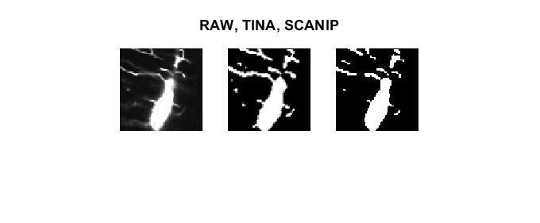
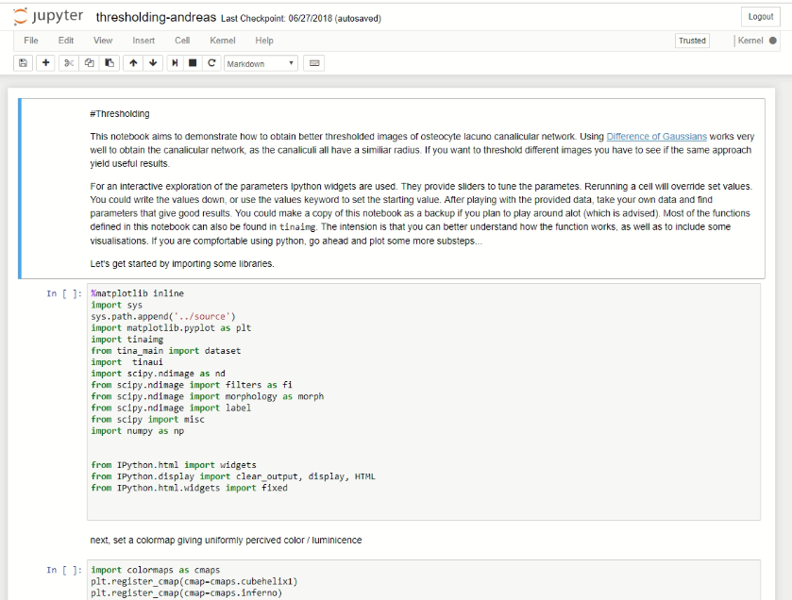
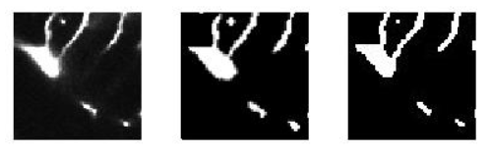
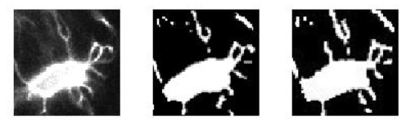
手动标记 vs DoG (高斯差异)
100 µm

Slide 15
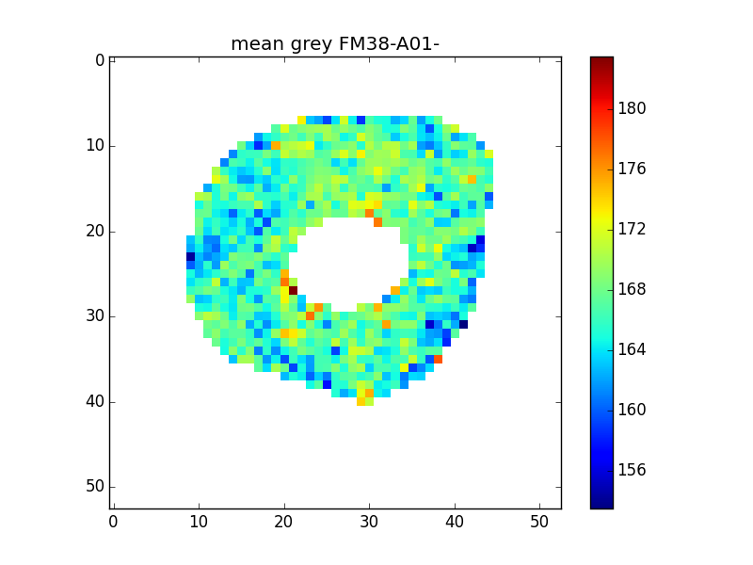
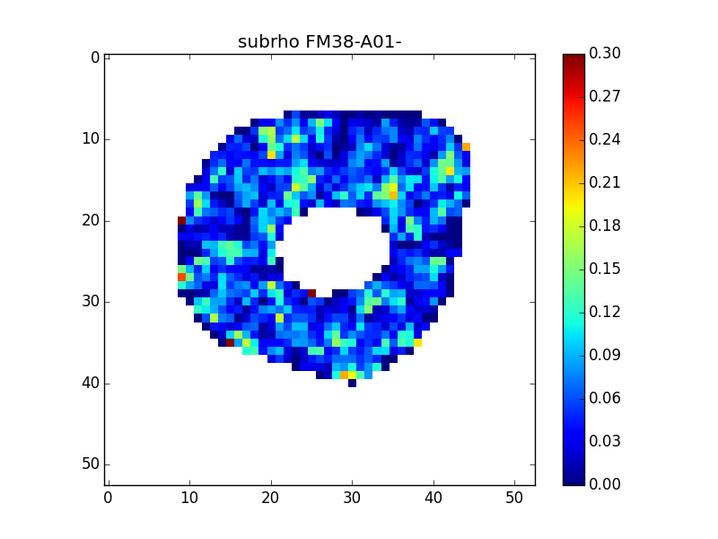
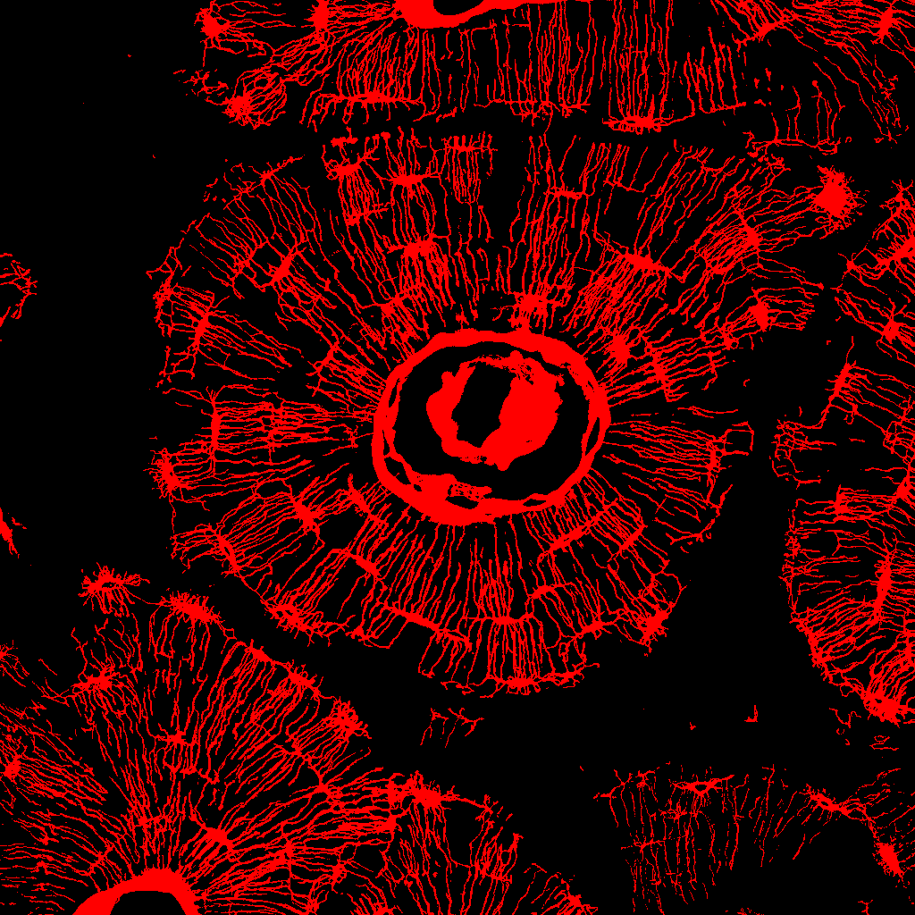
Network as a Calcium Reservoir
(Roschger, et al., Bone, 2019)
Quantitative Backscattered Electron Imaging (qBEI)
Confocal Laser Scanning Microscopy (CLSM)
Measured Slope
Expected Slope
Denser Network ➔ Higher Porosity ➔ Less Mineral
Within an osteon regions with denser network exhibit higher Ca content.
Results are consistent over all samples (100+).

Slide 16
Calvarial Suture Joint
Marrow Chamber and Blood Vessel (microCT)
Osteocyte Network (CLSM)
(Chen, et al., Unpublished data)

